Slide 1
Best Features In RFMS You Are Not Using
Tony Cargill
Jerry Miller

Slide 2
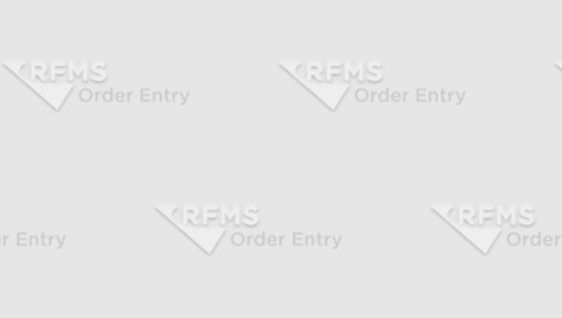
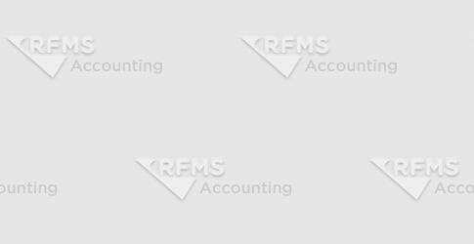
Best Features Not Being Used
Background in Each Module

Slide 3
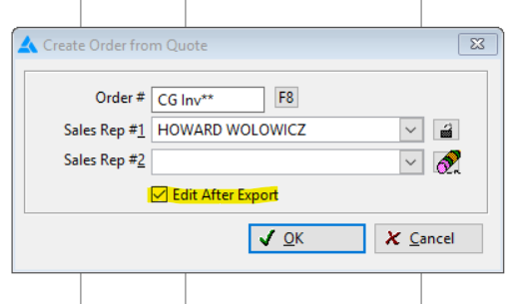
Best Features Not Being Used
Edit After Export Button

Slide 4
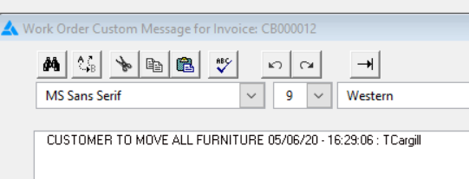
Best Features Not Being Used
Date Stamp

Slide 5
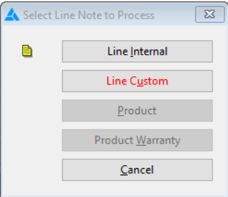
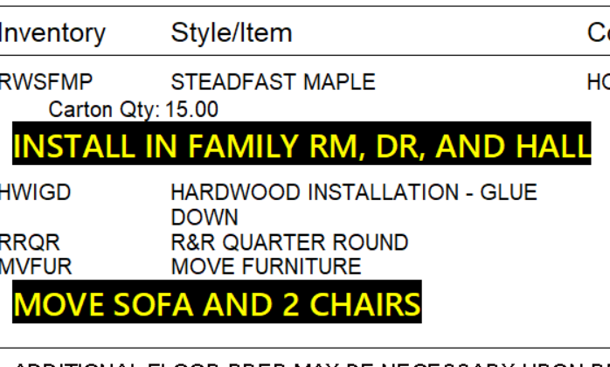
Best Features Not Being Used
Custom Line Notes

Slide 6
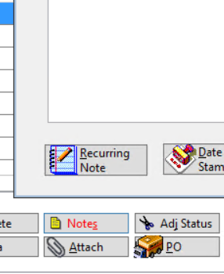
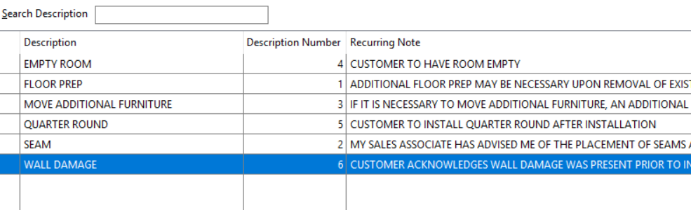
Best Features Not Being Used
Recurring Note Button

Slide 7
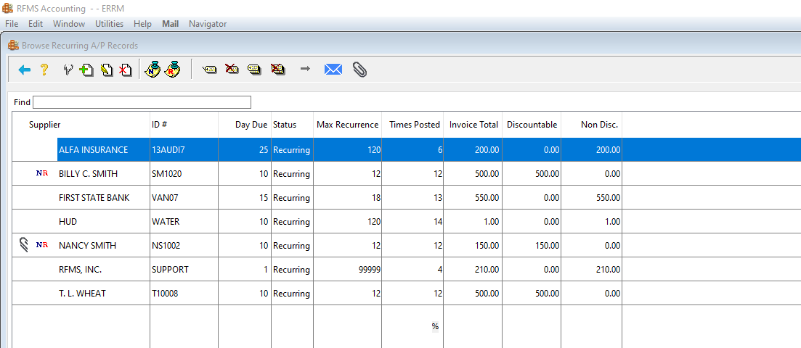
Best Features Not Being Used
Recurring A/P

Slide 8
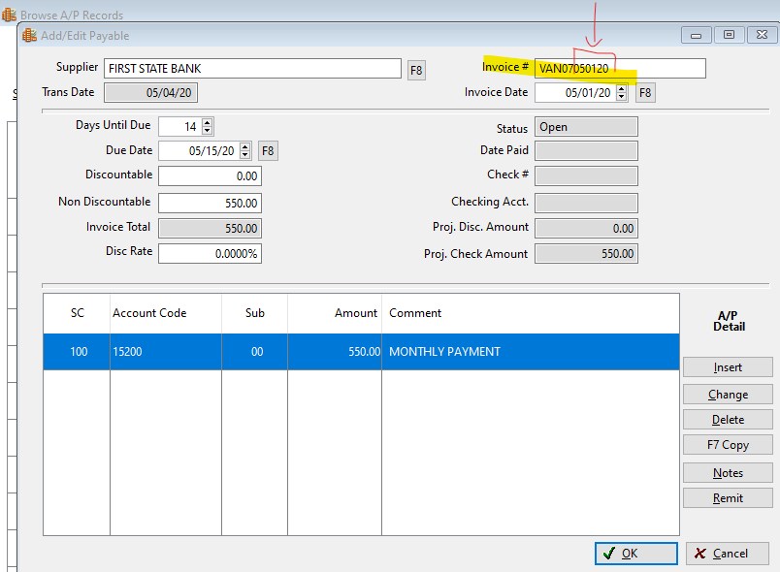
Best Features Not Being Used
Recurring A/P

Slide 9
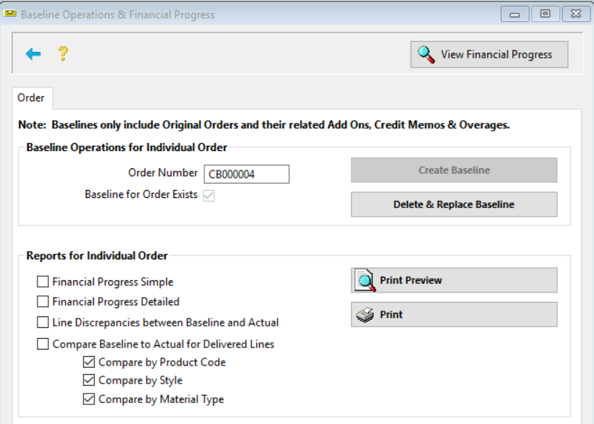
Best Features Not Being Used
Baseline

Slide 10
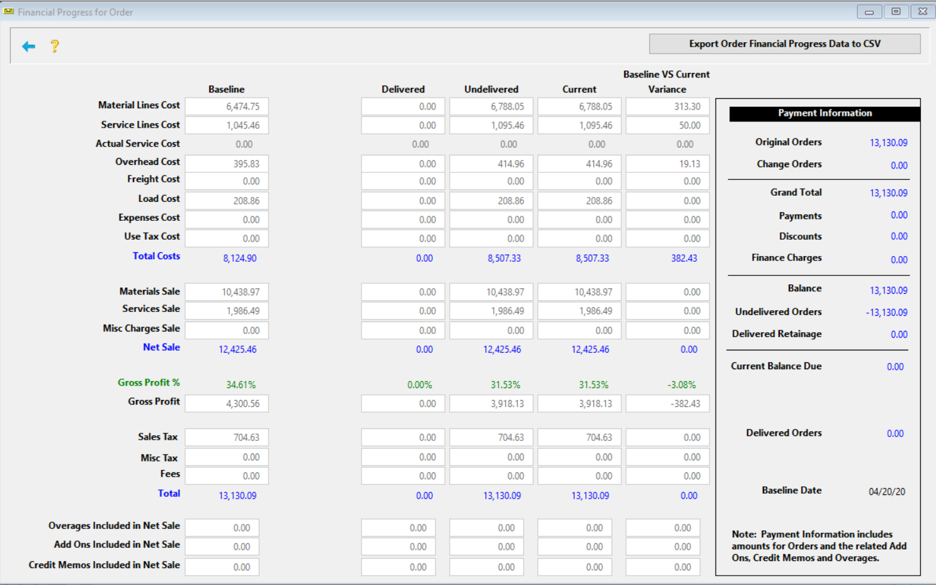
Best Features Not Being Used
Baseline

Slide 11
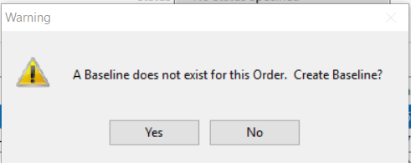

Best Features Not Being Used
Baseline Creation
Require Baseline Creation

Slide 12
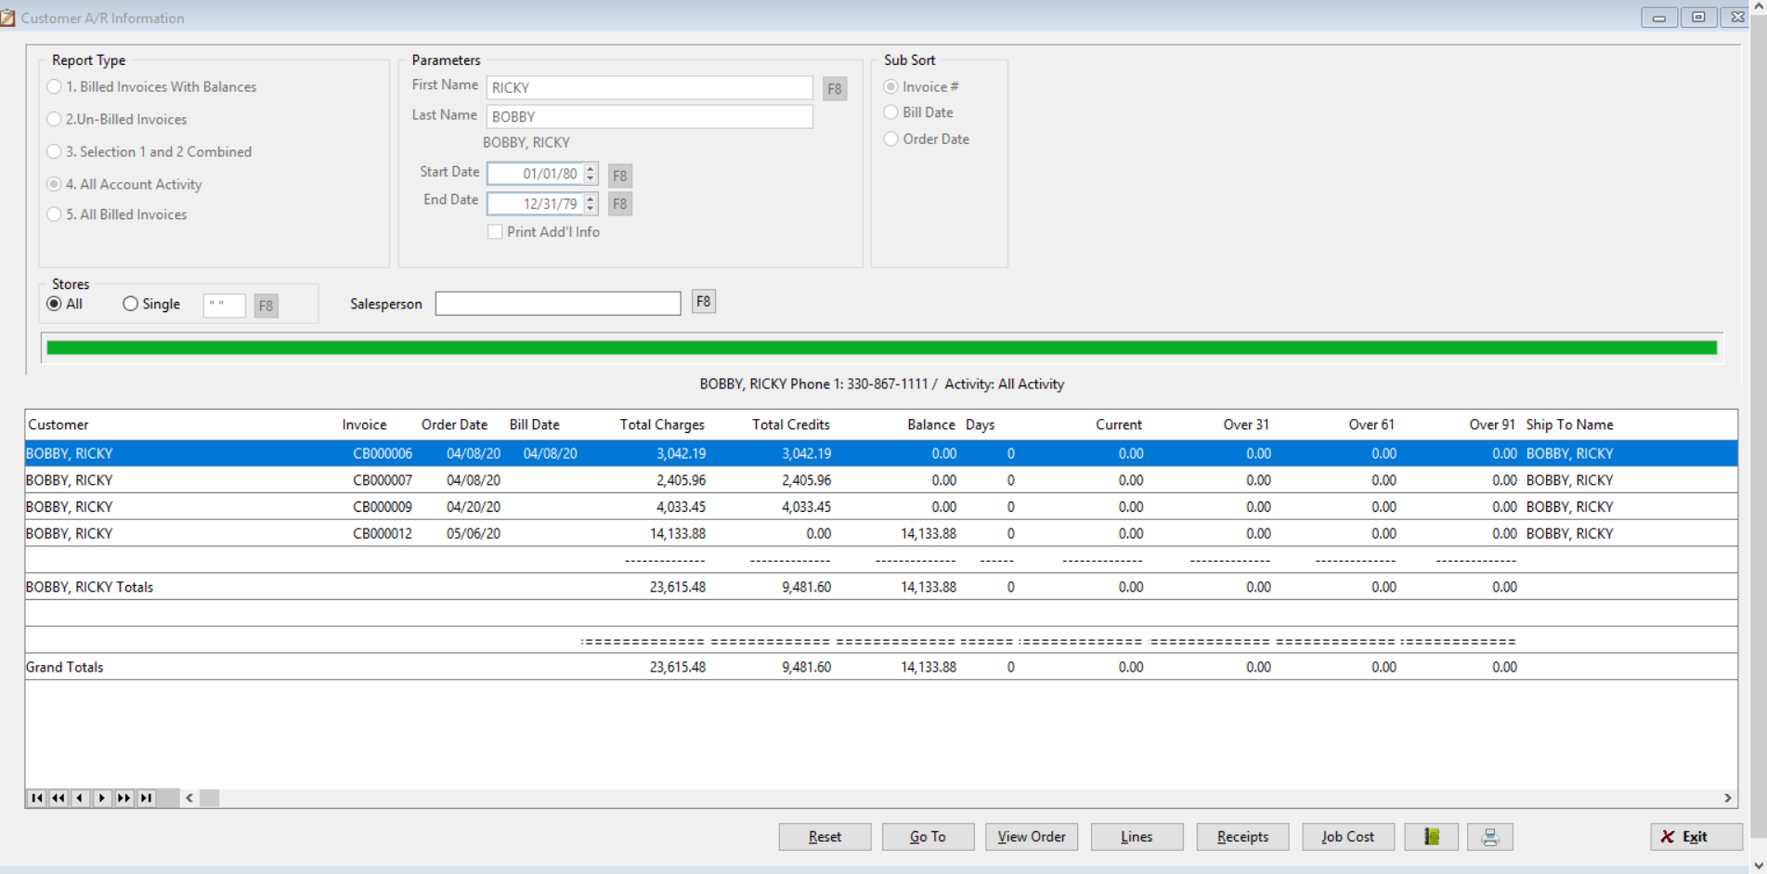

Best Features Not Being Used
Due Button

Slide 13
Best Features Not Being Used
Binoculars - JERRY

Slide 14
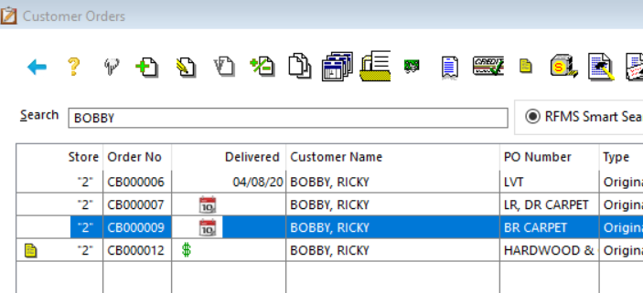
Best Features Not Being Used
PO Number Field

Slide 15
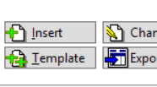
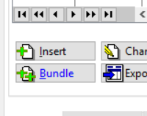
Best Features Not Being Used
Templates and Associated Bundles

Slide 16

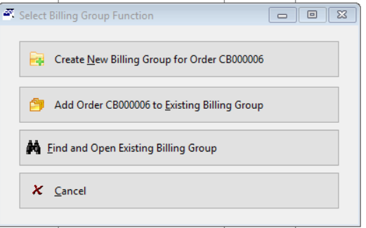
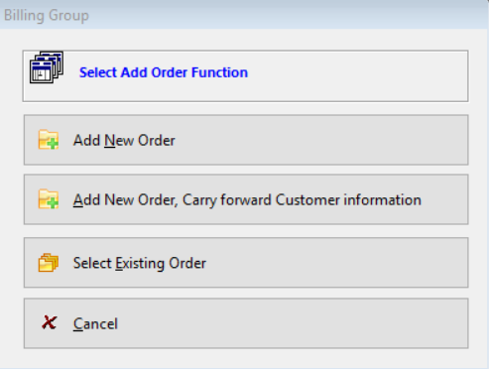
Best Features Not Being Used
Billing Groups

Slide 17
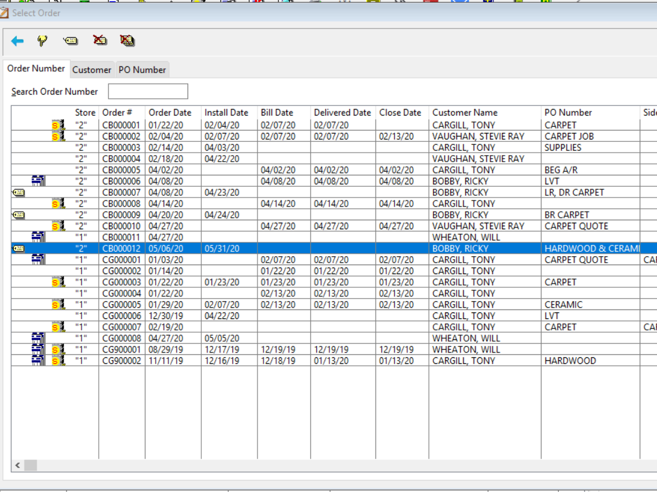
Best Features Not Being Used
Billing
Groups

Slide 18
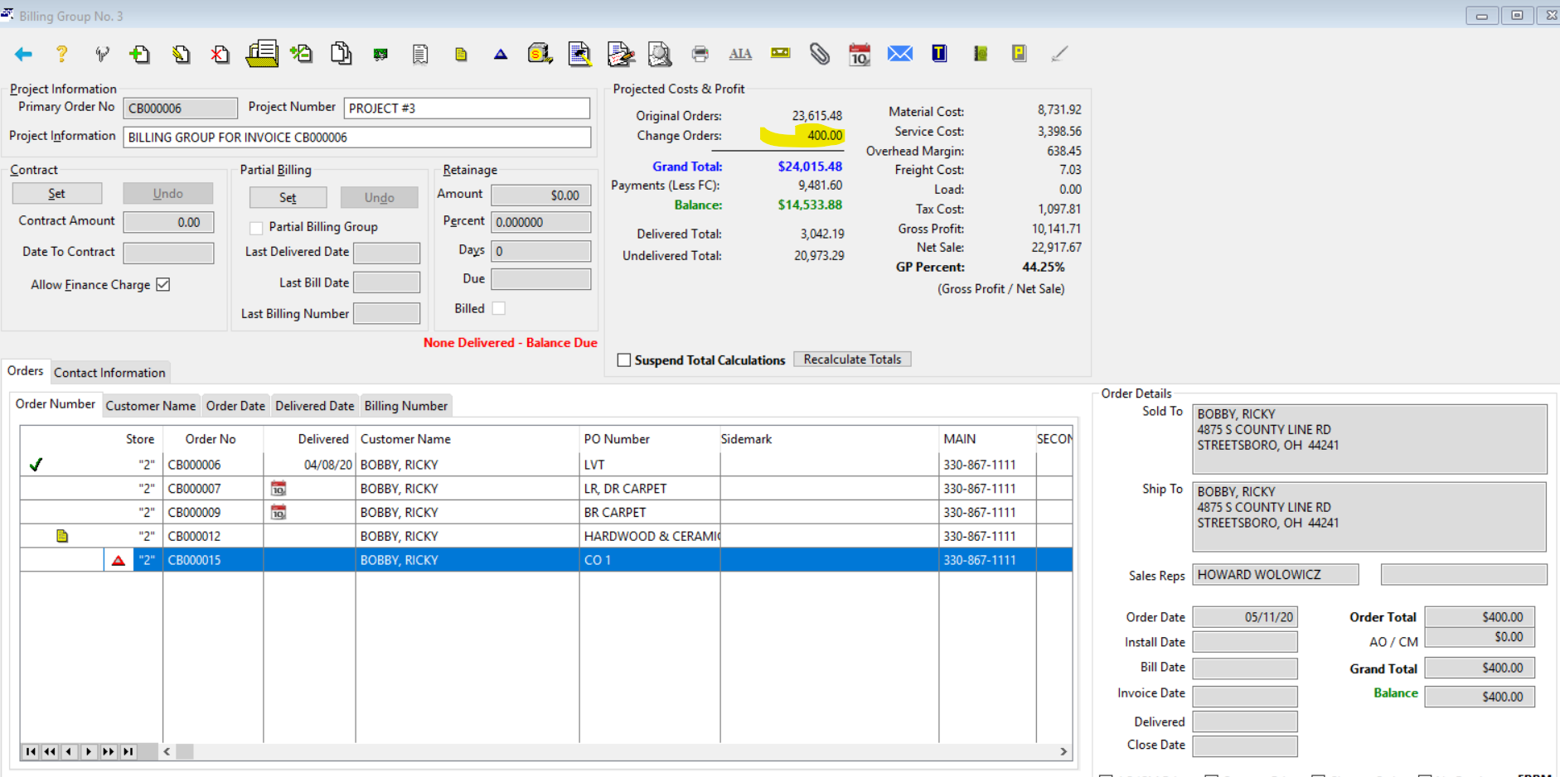
Best Features Not Being Used
Billing
Groups

Slide 19
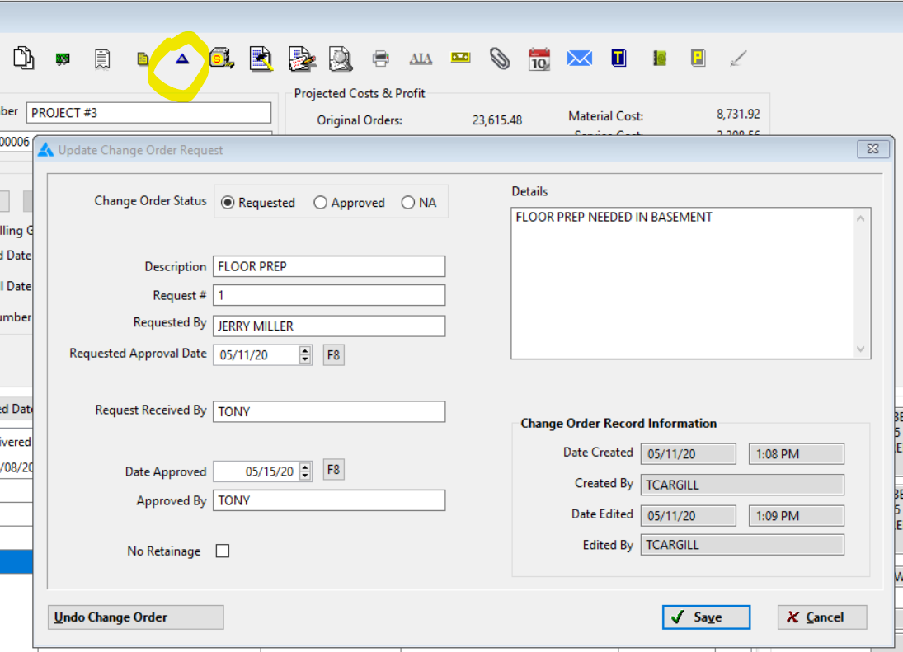
Best Features Not Being Used
Billing Groups
Change Order

Slide 20
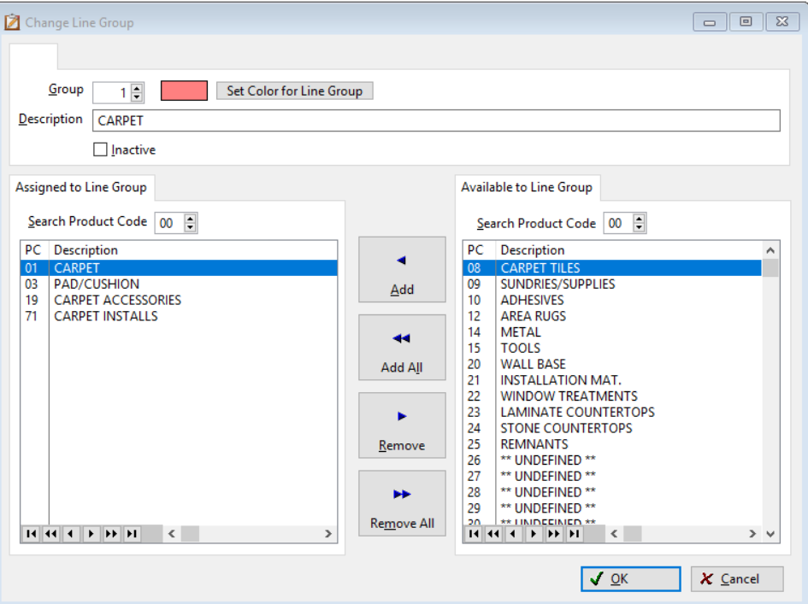
Best Features Not Being Used
Line Grouping

Slide 21
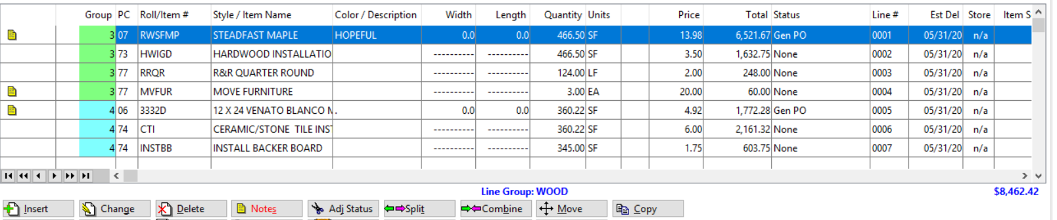
Best Features Not Being Used
Line
Grouping

Slide 22
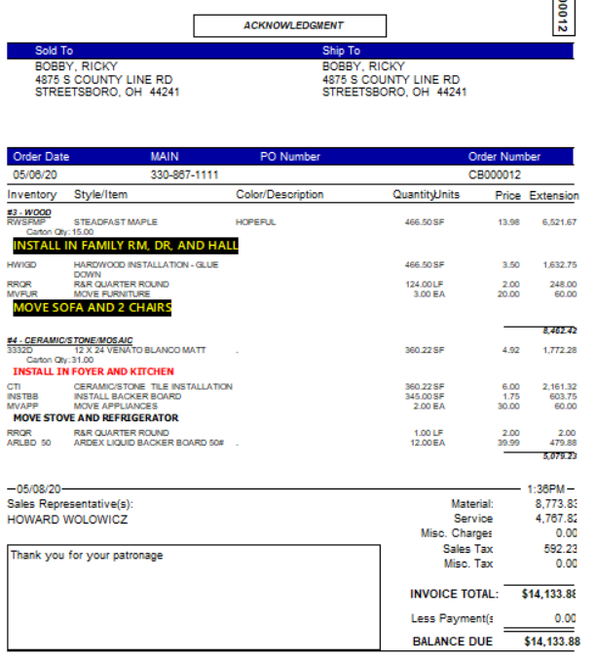
Line
Grouping

Slide 23
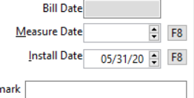

Best Features Not Being Used
Estimated Delivery Date for Just in Time Purchasing

Slide 24
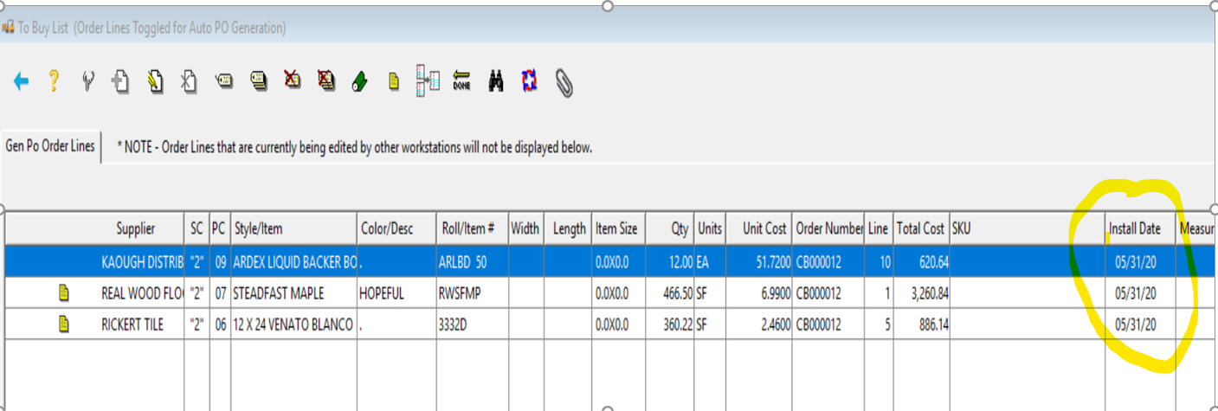
Best Features Not Being Used
Estimated Delivery Date for Just in Time Purchasing

Slide 25

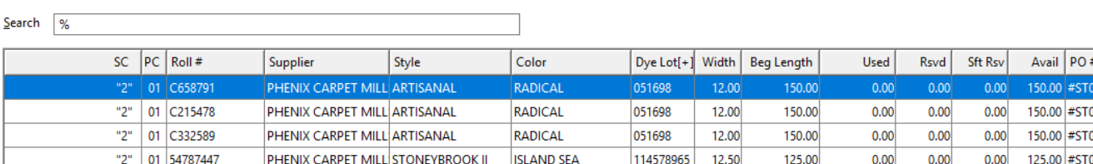
Best Features Not Being Used
View Dye Lot Information

Slide 26
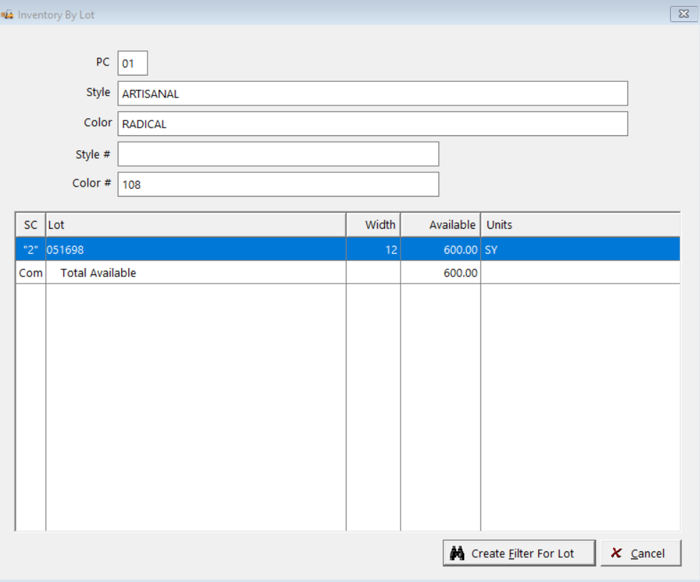
Best Features Not Being Used
View Dye Lot
Information

Slide 27
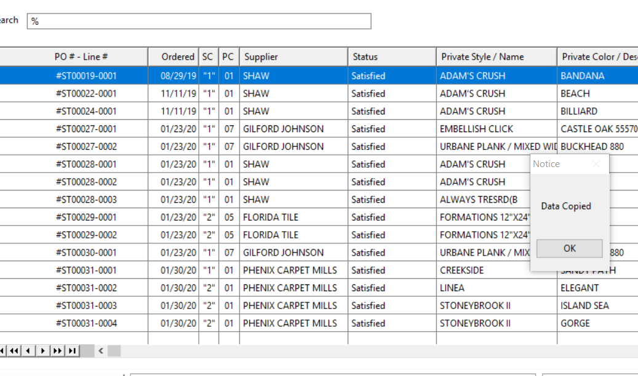
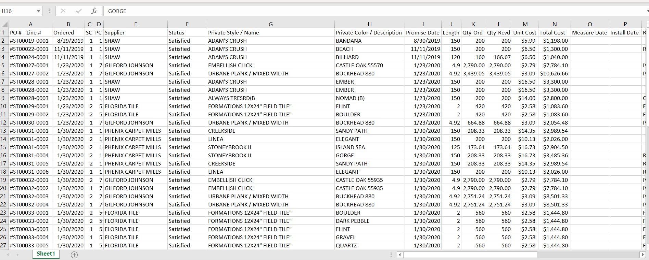
Best Features Not Being Used
Copy Browse – CTL+ALT+SHIFT+C

Slide 28
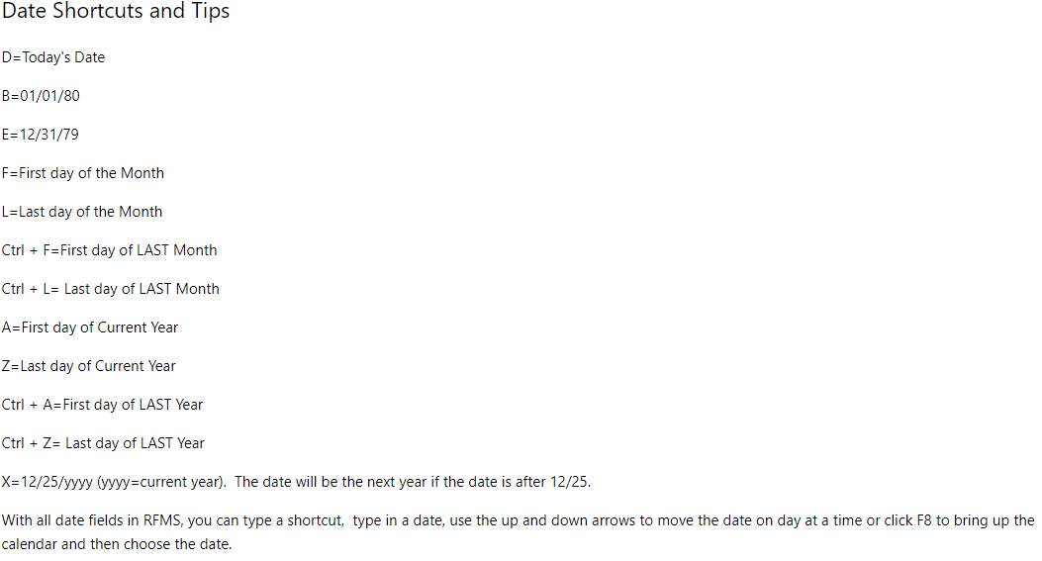
Best Features Not Being Used
Date Shortcuts

Slide 29
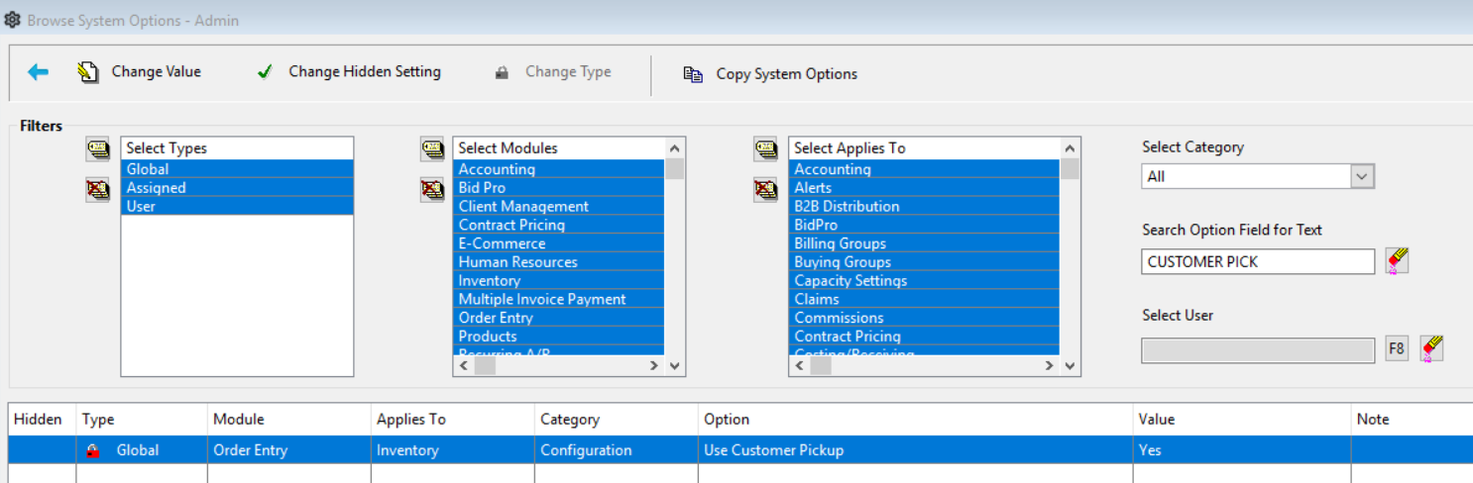
Best Features Not Being Used
Customer Pickup

Slide 30
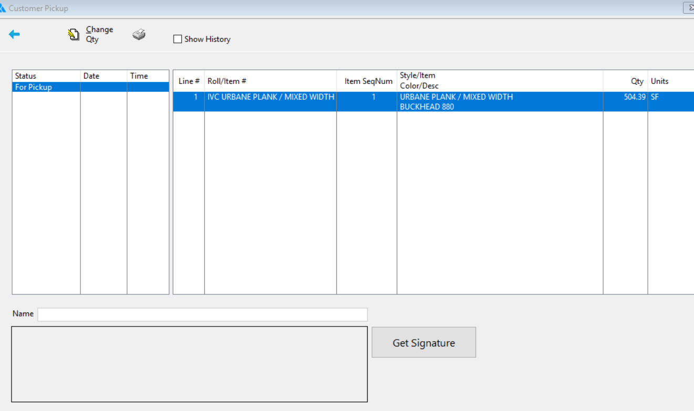

Best Features Not Being Used
Customer Pickup

Slide 31
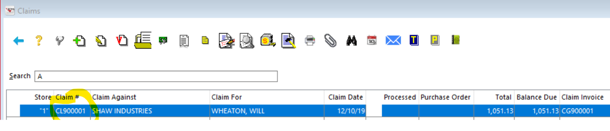
Best Features Not Being Used: BONUS #1 - Claims

Slide 32
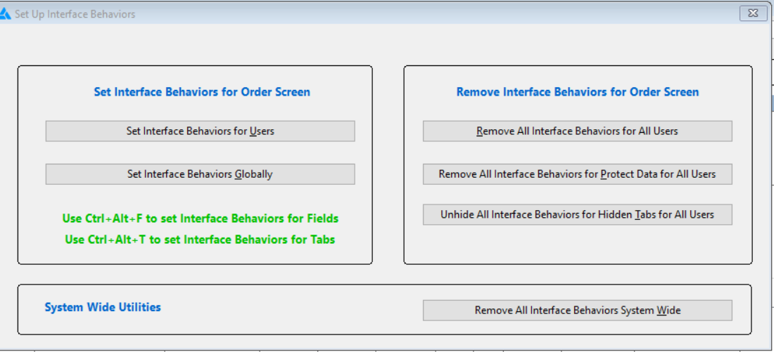
Best Features Not Being Used – BONUS #2
Interface Mode – Gives the ability to determine which fields are required when inserting or entering a record. CTL+ALT=F9

Slide 33
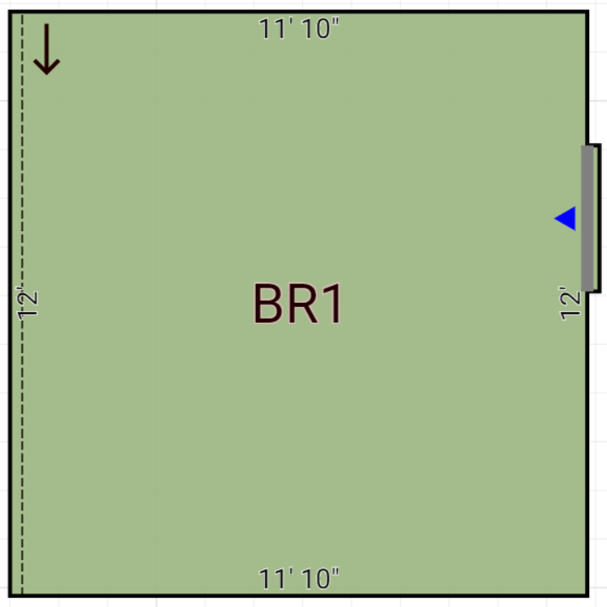
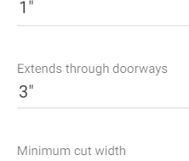
Best Features Not Being Used – BONUS #3
In Measure Mobile/Desktop: Extends through Doorways setting can add a seam to a 12’ room

Slide 34

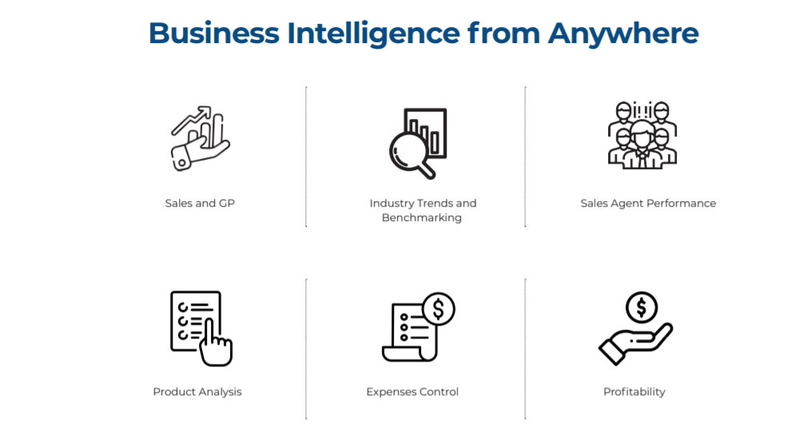
Business Insights– BONUS #3

Slide 35


Slide 36
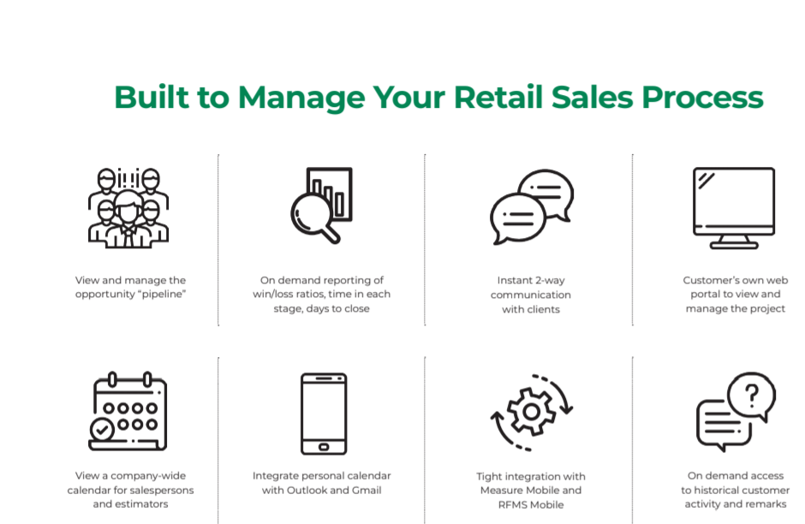
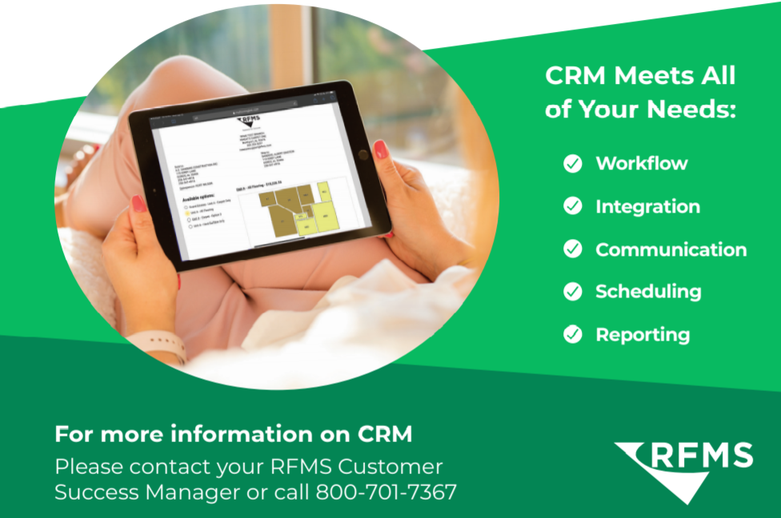
CRM App

Slide 37
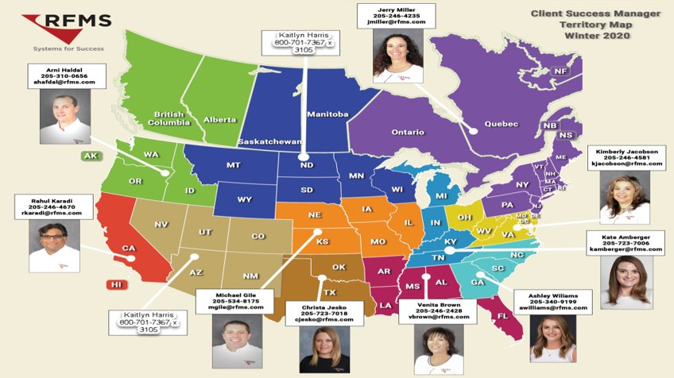

Slide 38

CONGRATULATIONS

Slide 39
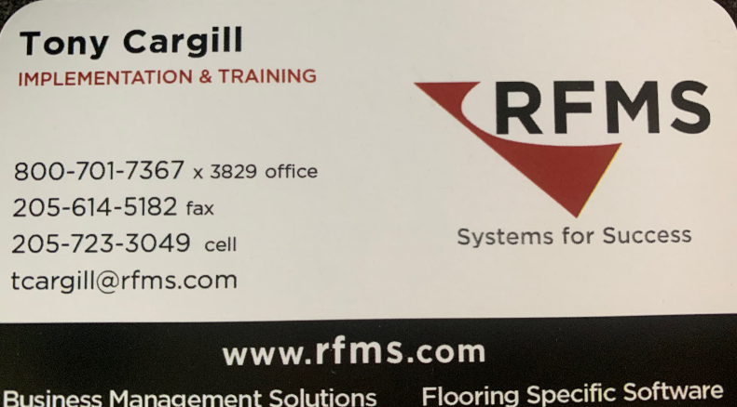
Contact Information:
EMAIL OR CALL TO SET UP YOUR 1 FREE HOUR OF TRAINING
      CONGRATULATIONS!!!!!

Slide 40
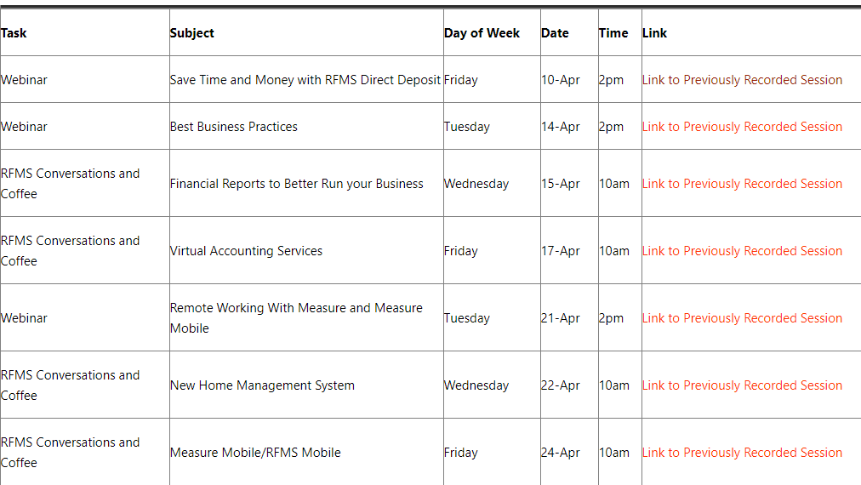
View Previously Recorded C&C and Webinars
https://rfmsinc.zendesk.com/hc/en-us/articles/360045988234-Spring-Webinars-PLUS-introducing-Conversations-and-Coffee-

Slide 41


