Slide 1
The Little Things in RFMS to Help You Close More Sales
Tony Cargill

Slide 2
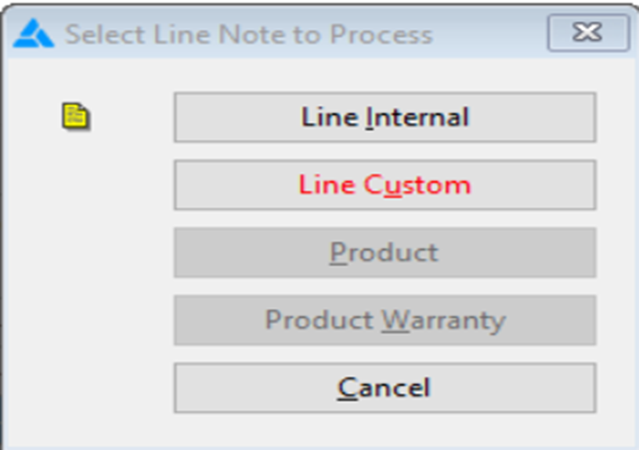
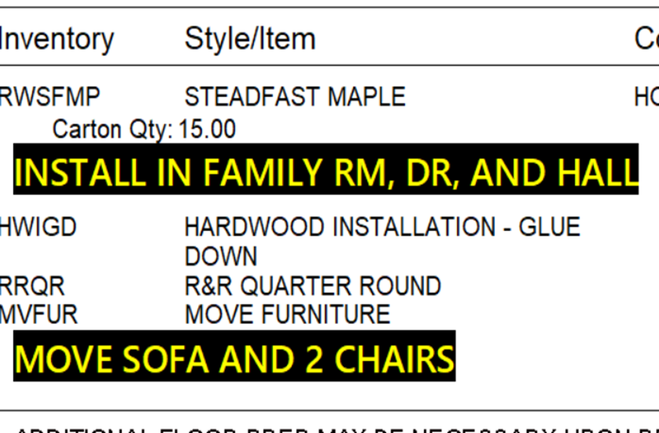
The Little Things in RFMS to Help You Close More Sales

Slide 3


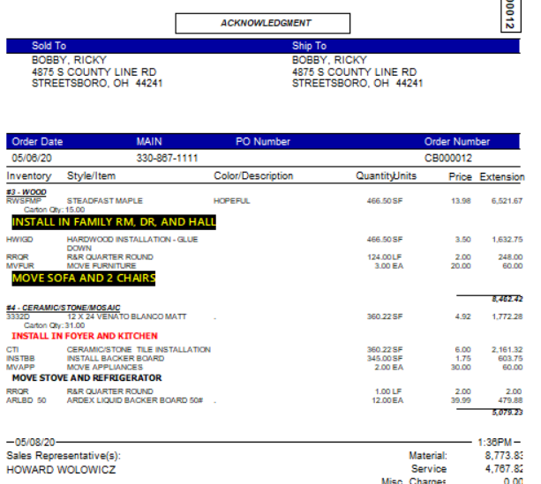

The Little Things in RFMS to Help You Close More Sales
Line Grouping

Slide 4
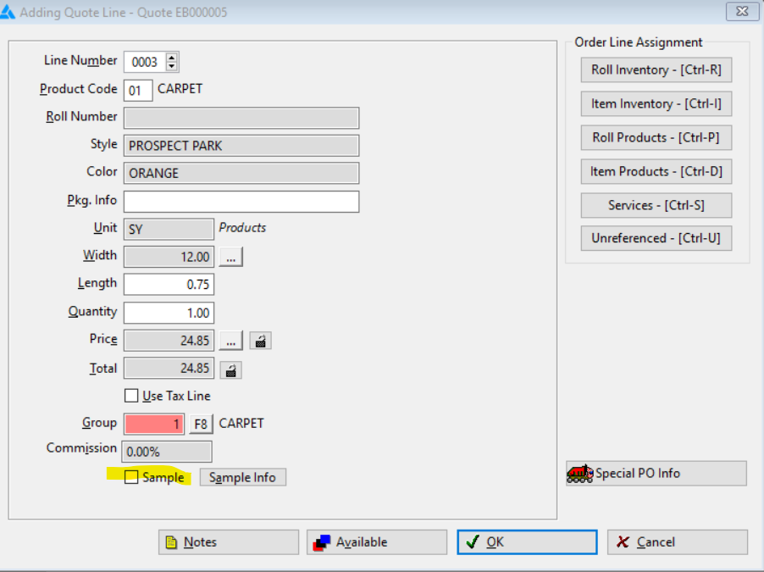
The Little Things in RFMS to Help You Close More Sales
Track Samples

Slide 5
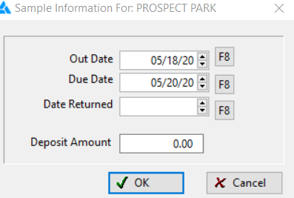
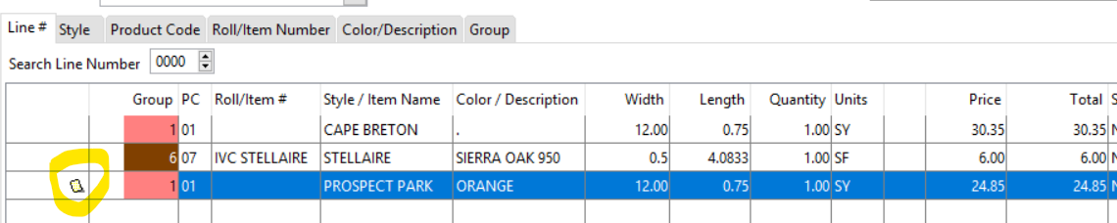
The Little Things in RFMS to Help You Close More Sales

Slide 6
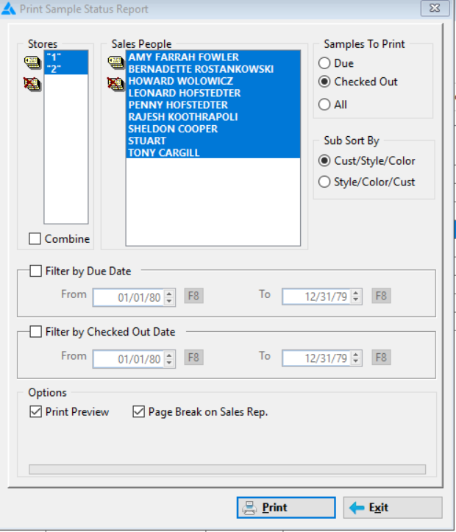


The Little Things in RFMS to Help You Close More Sales
Sample Icons

Slide 7
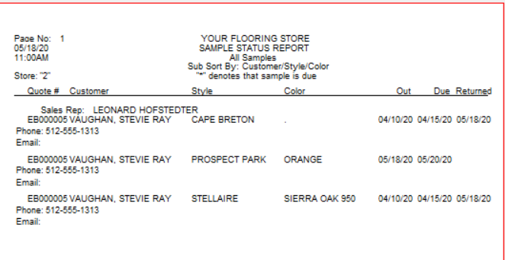
The Little Things in RFMS to Help You Close More Sales

Slide 8
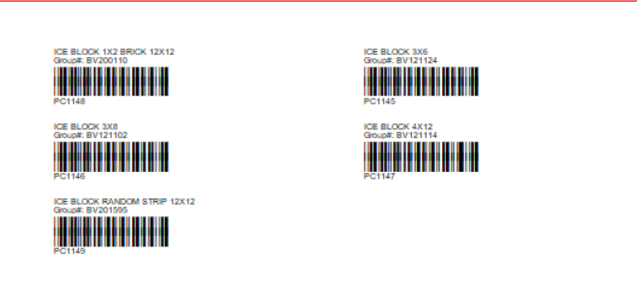
The Little Things in RFMS to Help You Close More Sales
Barcode Your Showroom

Slide 9
The average new hire is fully productive in 5.3 months. 24% are ready in 1–3 months, and 16% take longer than 7 months
ForEntrepreneurs and The Bridge Group
High performing sales teams pay close attention to training, and see 9% faster revenue growth as a result

Slide 10
The Little Things in RFMS to Help You Close More Sales
Invest in Training
  Sales Training - You can get anything you want if you help enough other people get what they want. (Zig Ziglar)
  Vendor Training
  Measure On-site Visits
  Installation On-site Visits

Slide 11
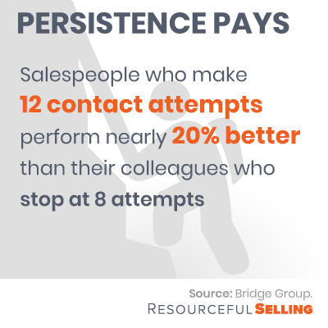

Slide 12
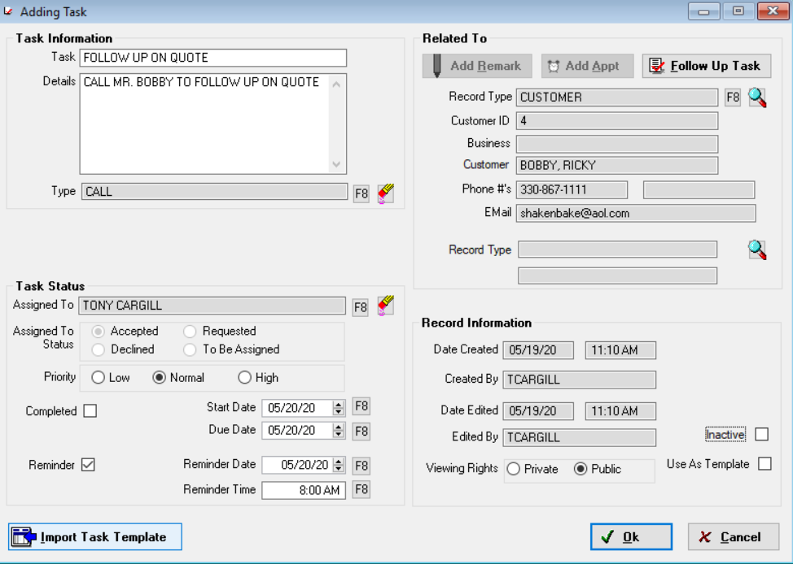
The Little Things in RFMS to Help You Close More Sales
Use Tasks in Client Management

Slide 13
Acquiring a new customer costs 5–25 times more than keeping an existing customer
Harvard Business Review
RFMS Can Help

Slide 14
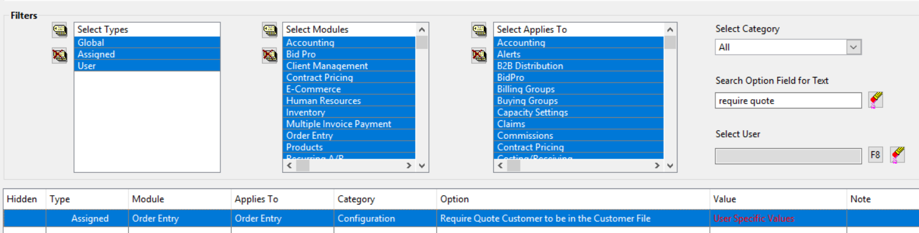
The Little Things in RFMS to Help You Close More Sales
Use the Customer File – Require Customers to be in Customer File

Slide 15
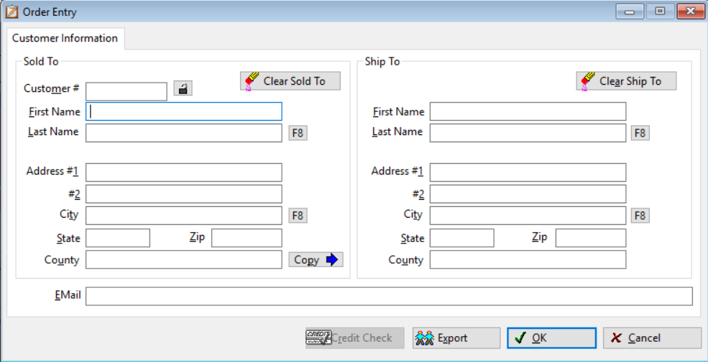
The Little Things in RFMS to Help You Close More Sales

Slide 16
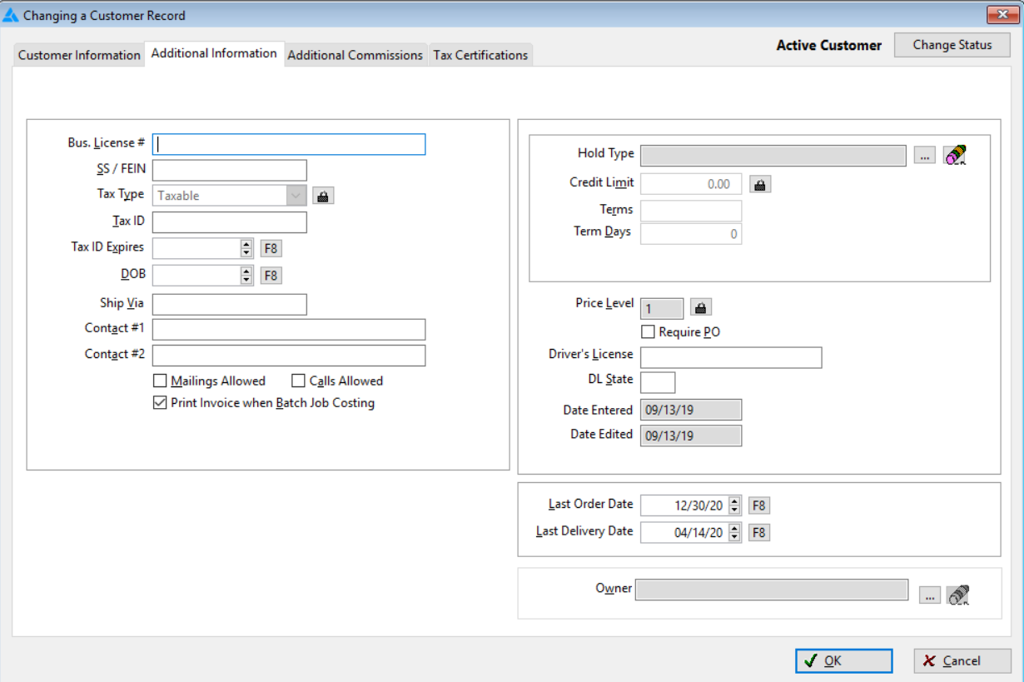
The Little Things in RFMS to Help You Close More Sales
Use the “Additional Information” tab in the Customer File

Slide 17
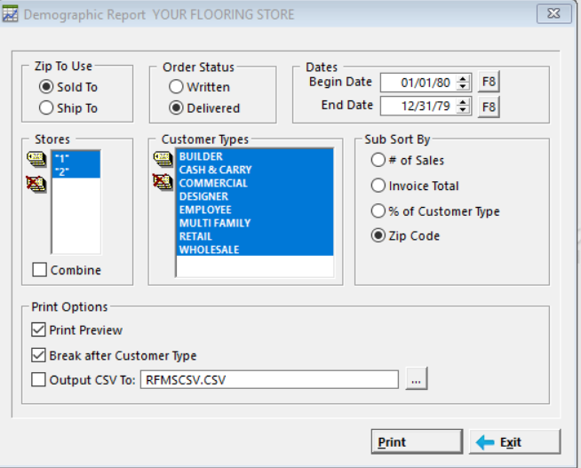
The Little Things in RFMS to Help You Close More Sales
Use the Sales Reports Module
  -Demographics Report

Slide 18
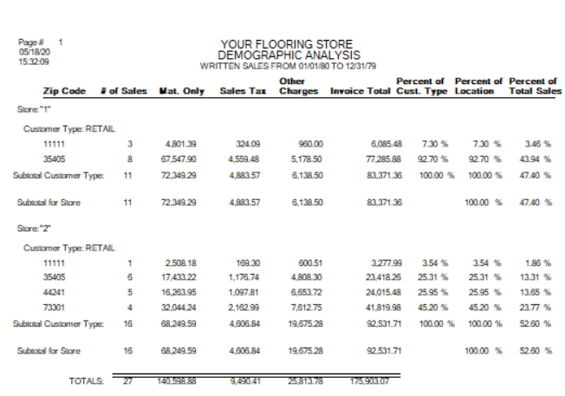
The Little Things in RFMS to Help You Close More Sales
See Sales by Zip Code

Slide 19
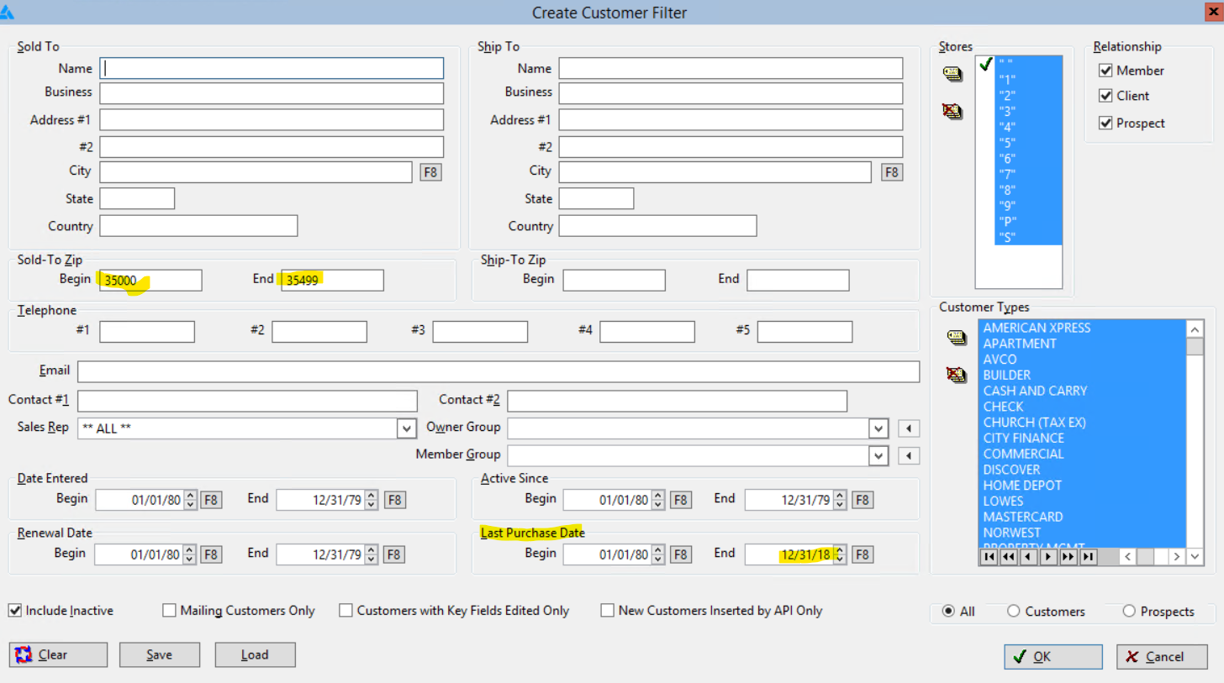

Slide 20
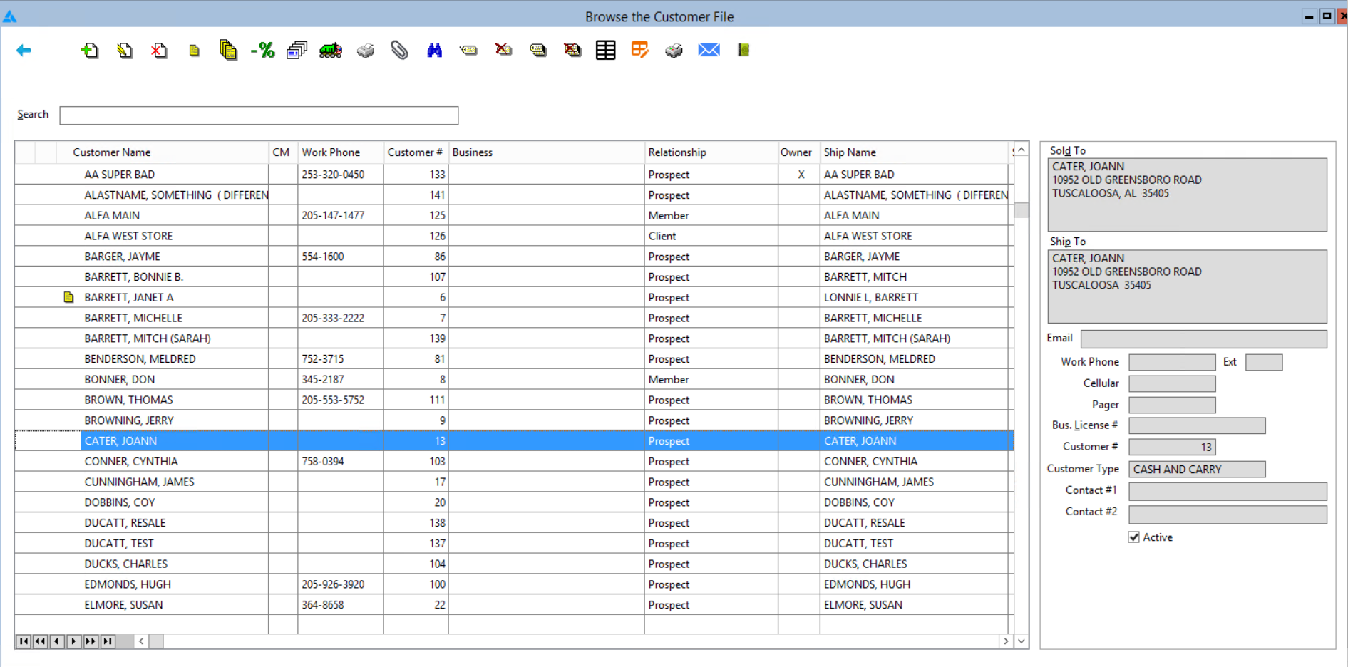

Slide 21
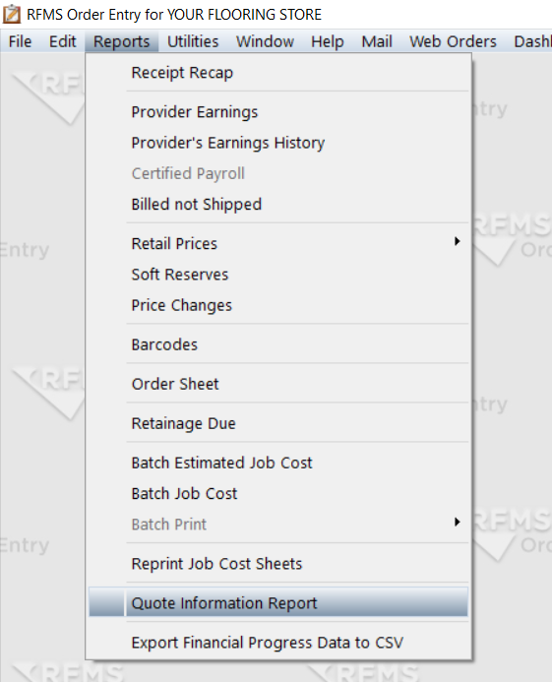
The Little Things in RFMS to Help You Close More Sales
Quote Information Report

Slide 22
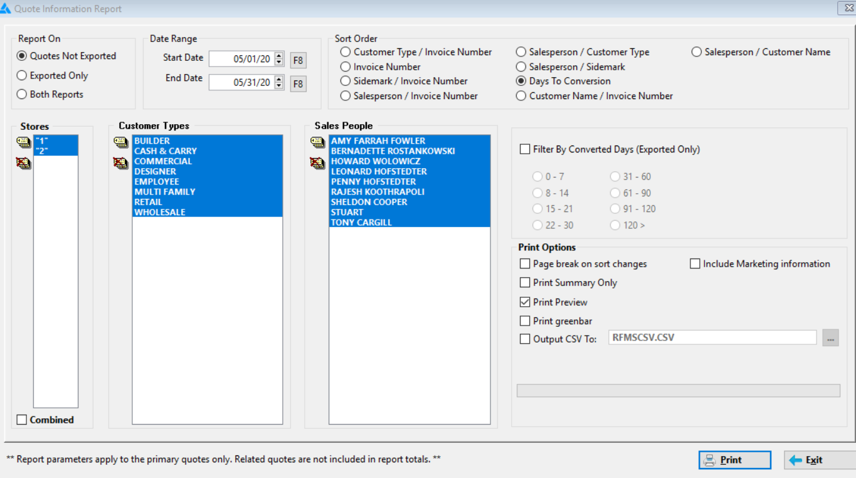

Slide 23
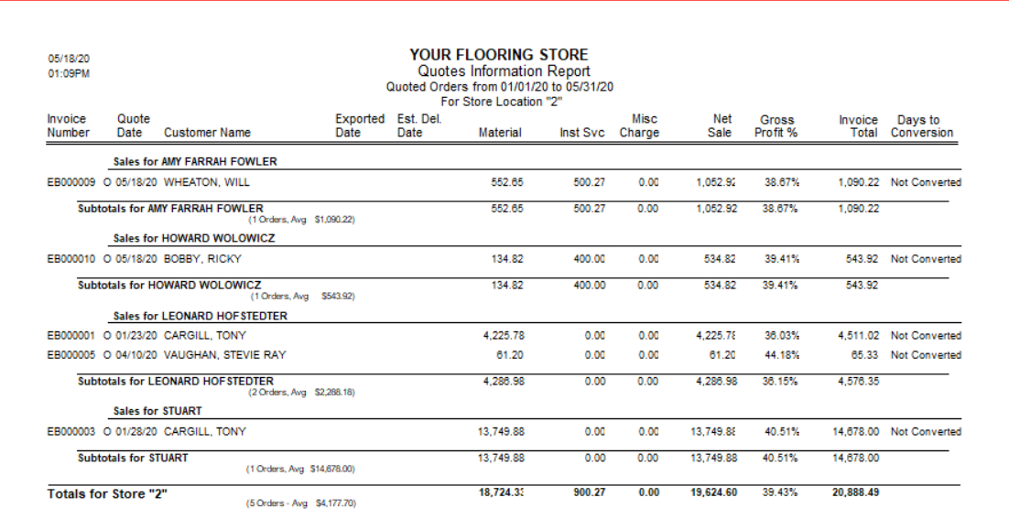

Slide 24
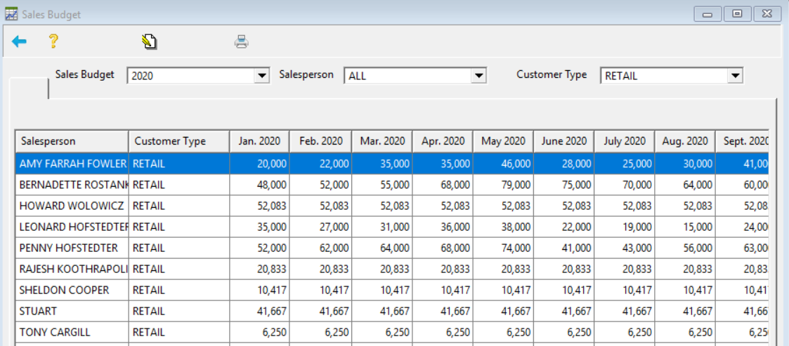
The Little Things in RFMS to Help You Close More Sales
Set Sales Budgets for Sales Associates
Set Sales Budgets for Sales Associates:
Gives them defined expectations
Drives them to succeed

Slide 25
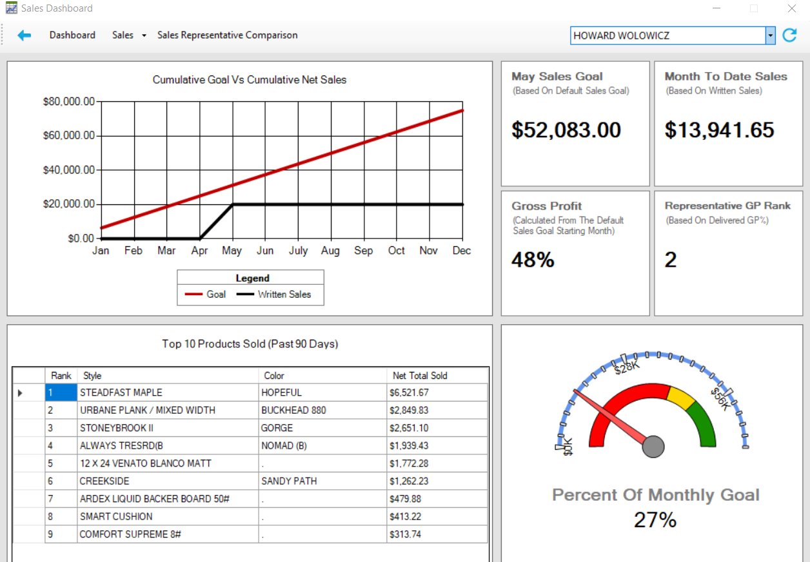
The Little Things in RFMS to Help You Close More Sales
Set Sales Budgets for Sales Associates:
Gives them defined expectations
Drives them to succeed

Slide 26
The Little Things in RFMS to Help You Close More Sales
Maintain Showroom
  Set up Product Sets
    Run Materials Analysis Report
      Purge Non-Productive Displays

Slide 27
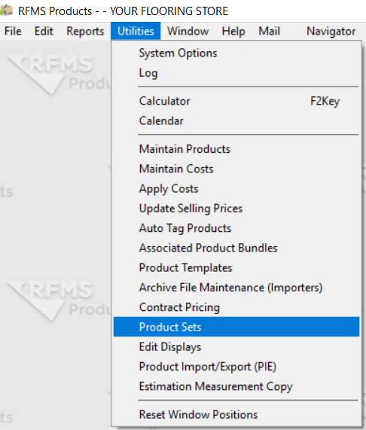
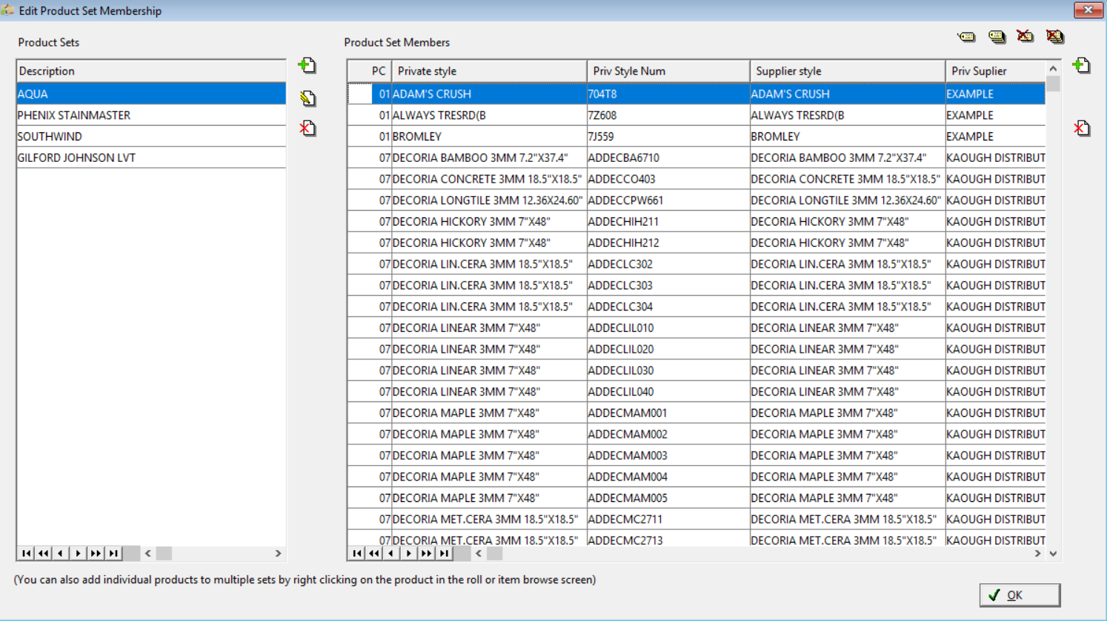
The Little Things in RFMS to Help You Close More Sales

Slide 28
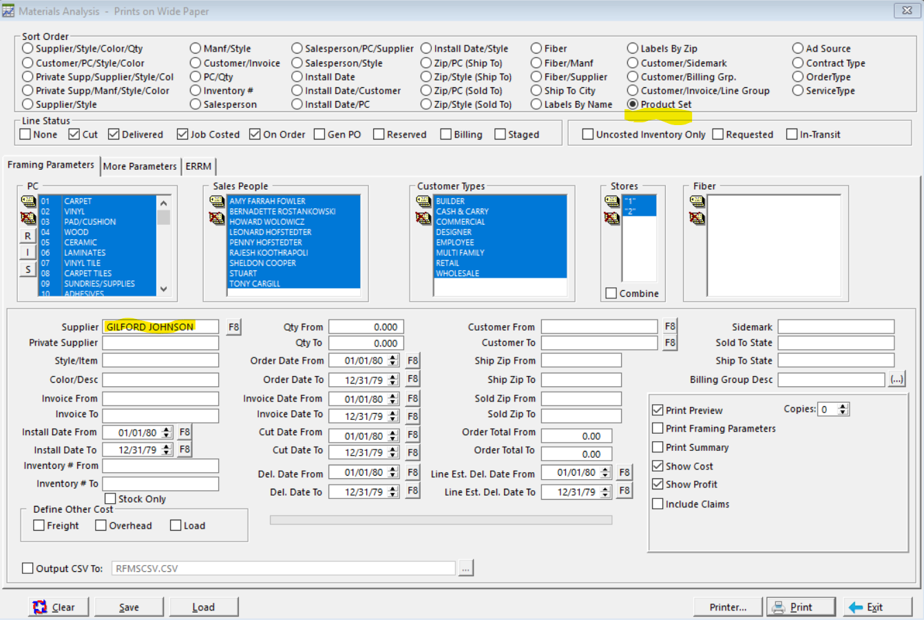
The Little Things in RFMS to Help You Close More Sales
Material Analysis Report

Slide 29
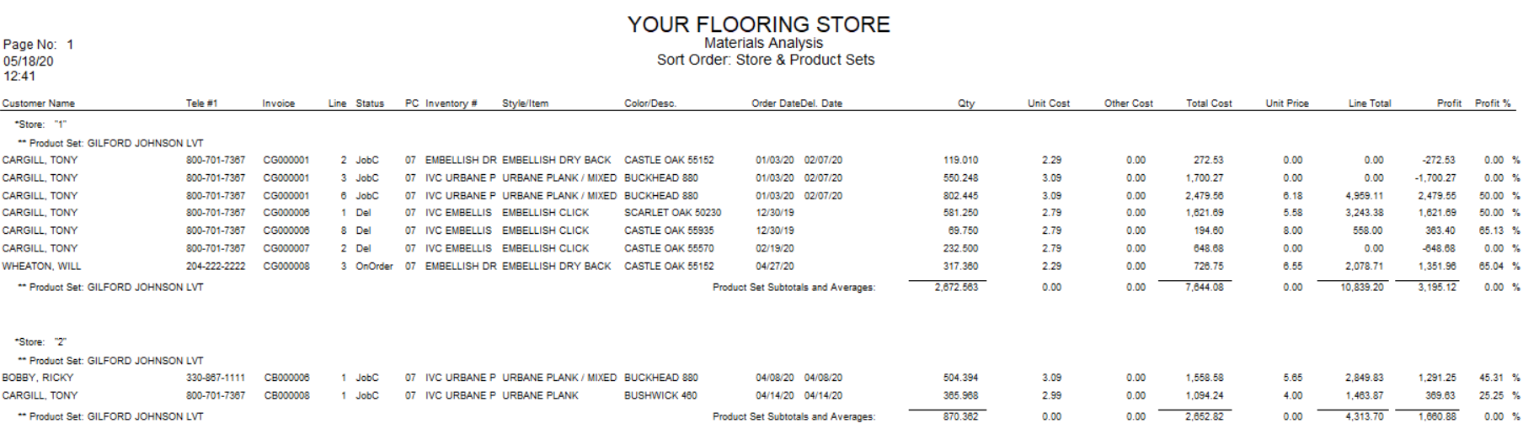

Slide 30
The Little Things in RFMS to Help You Close More Sales
Diversify
    Cabinets
    Countertops
    Lighting

Slide 31
The Little Things in RFMS to Help You Close More Sales
Close the Sale at the Measure
  Integrate RFMS Measure Mobile and RFMS MOE to quote accurately on the measure
    Use “Checklists” to speed up the process
  Will work exceptionally well with new app arriving soon

Slide 32
75%–85% of top salespeople value CRMs, productivity apps, email marketing, and social selling as key factors in their success.
(State of Sales, LinkedIn)
RFMS CRM App – Coming Soon!!

Slide 33
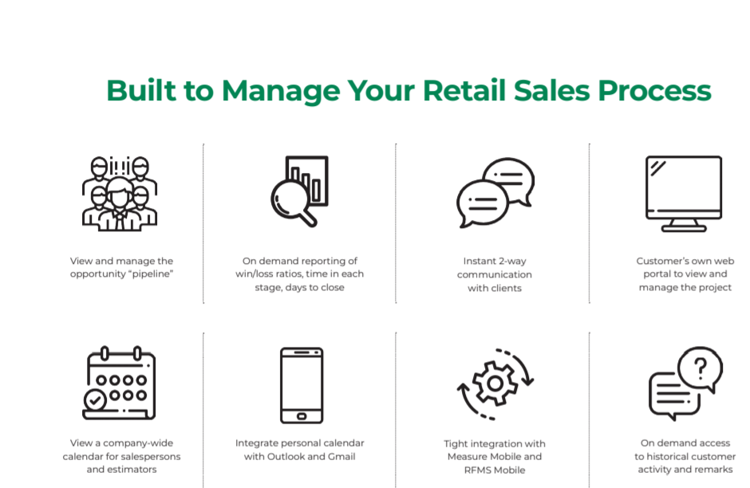
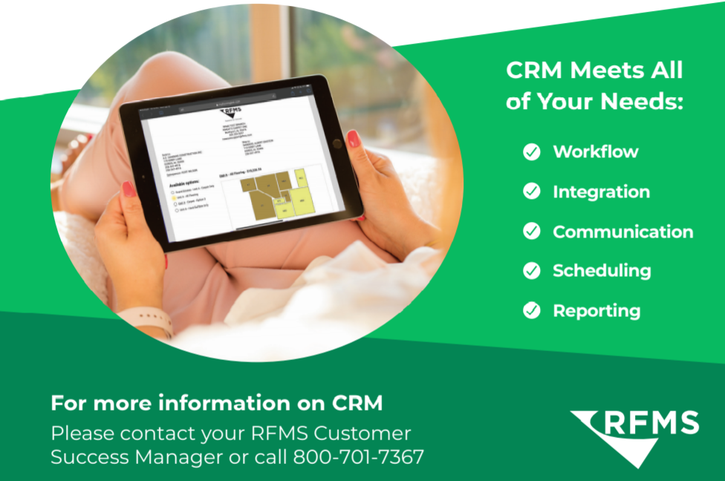
The Little Things in RFMS to Help You Close More Sales

Slide 34
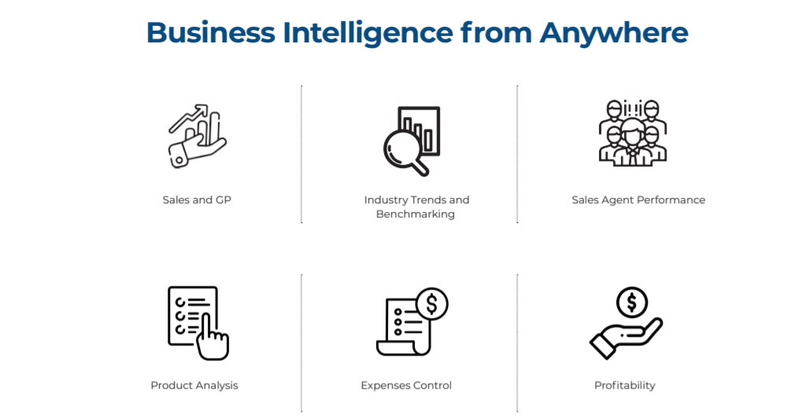

The Little Things in RFMS to Help You Close More Sales

Slide 35
